Slide 1
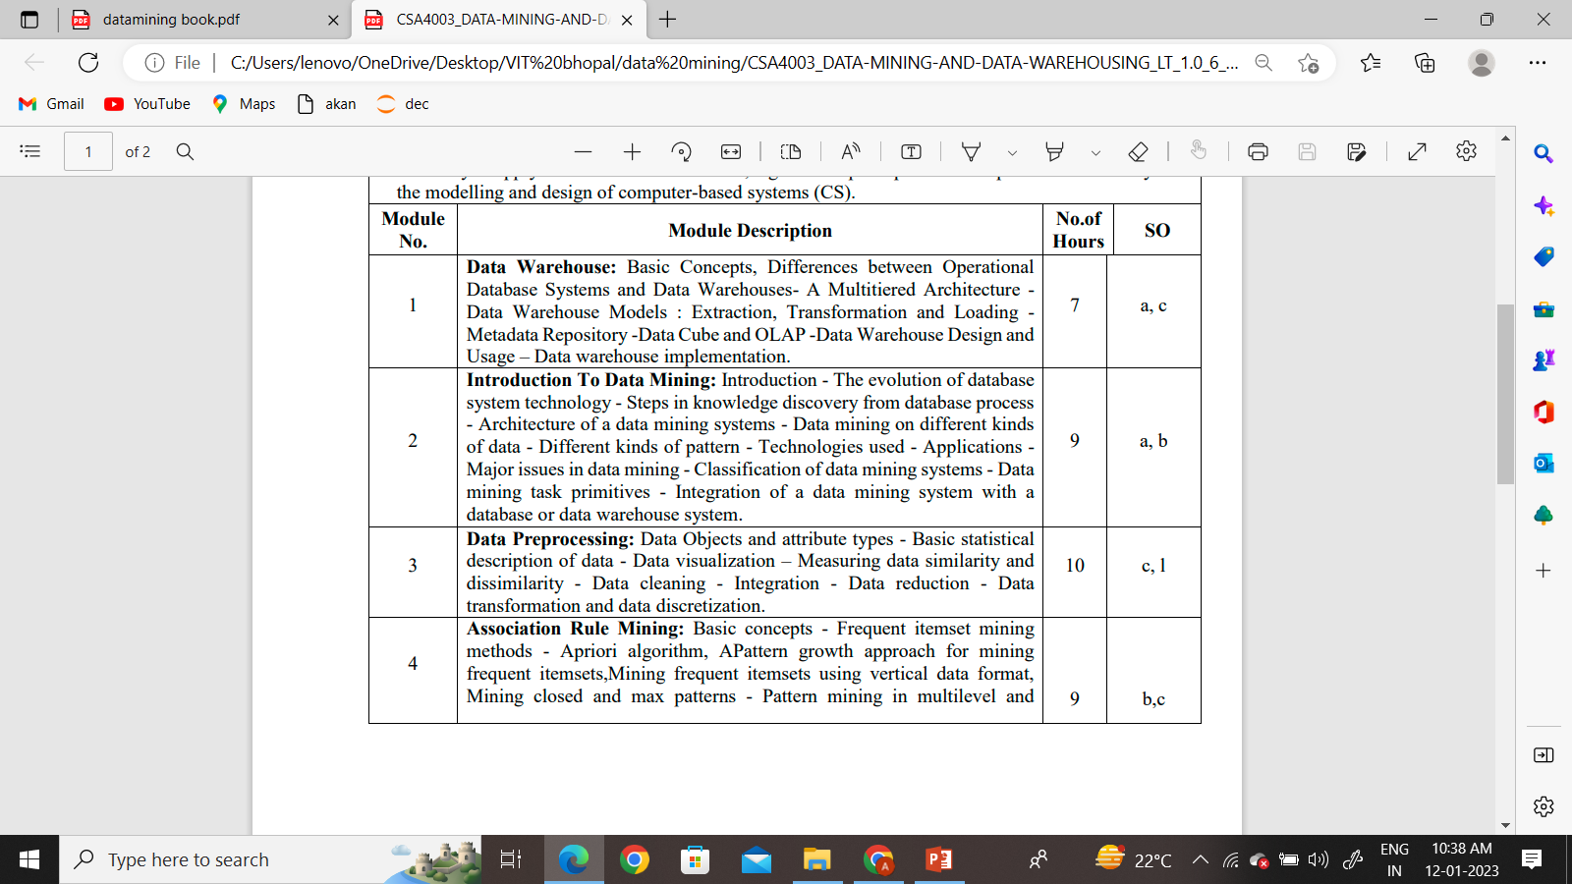
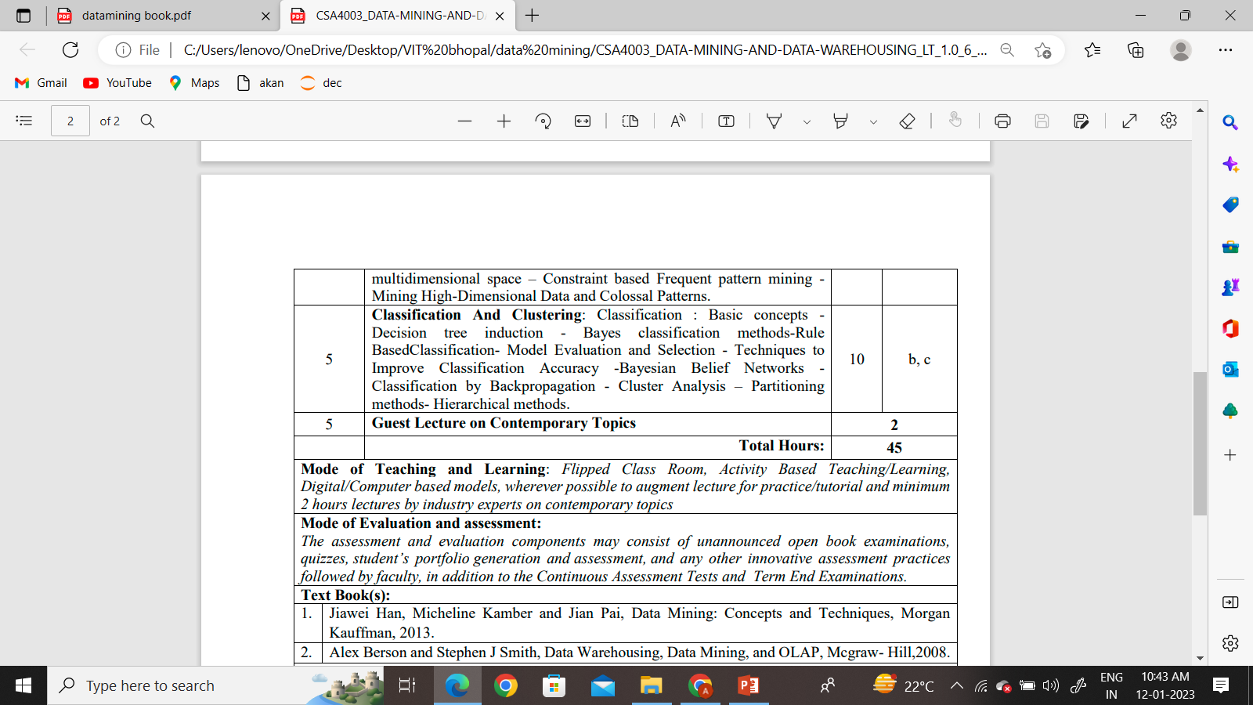

Slide 2
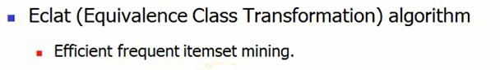
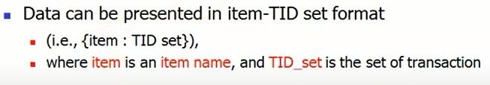
Vertical Data Format (for mining frequent item set)

Slide 3
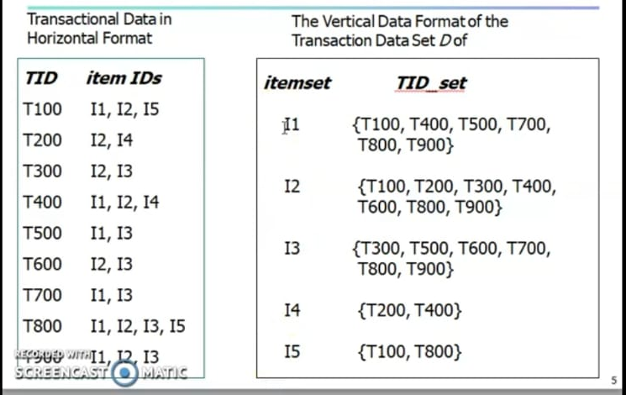
Mining frequent itemset using the vertical format
Support count
6
7
6
2
2
T900 I1,I2,I3

Slide 4
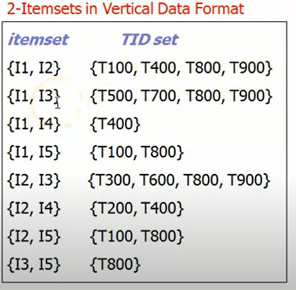
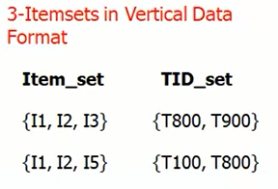
Assume
Min support=2
Support count
4
4
1
2
4
2
2
1
Remove the entry which has less then 2 support
Support count
2
2
Accepted
Try to find 4 itemset….

Slide 5
Closed and maximal itemsets
Frequent item set: It is an item set whose support is greater than some user-specified minimum support
Closed frequent Item set: An itemset is closed if none of its immediate supersets has the same support as that of the itemset.
Maximal frequent itemset: A itemset is maximal frequent if none of its immediate supersets are frequent.

Slide 6
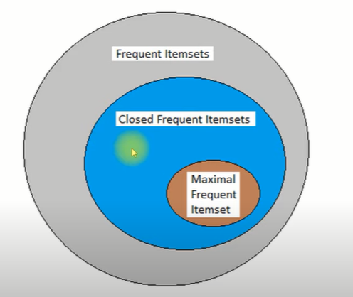
Closed and maximal itemsets
Closure property of any frequent itemset must also be frequent.
Example: see the frequent pattern generation in FP-growth and Apriri.

Slide 7
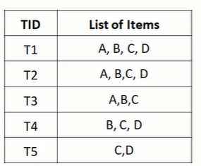
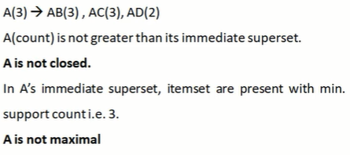
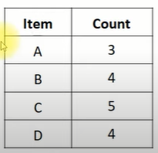
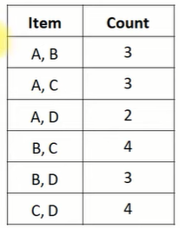
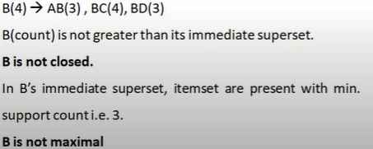
Find Frequent , Closed and Maximal itemset
Min supp. Count=3
Two frequent itemset
One frequent itemset
All items i.e. A, B, C, D are frequent because their support count is greater than or equal to minimum support count.

Slide 8
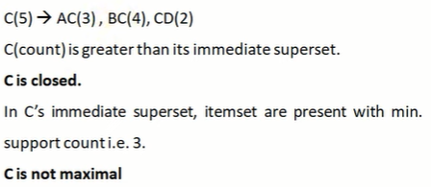
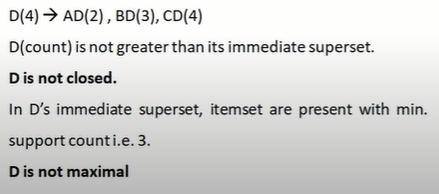
Find Frequent, Closed and Maximal itemset contd..

Slide 9
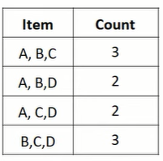
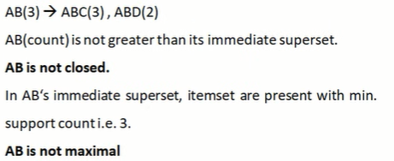
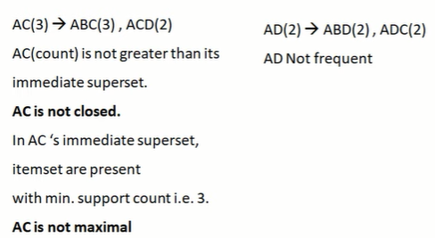
Find Frequent , Closed and Maximal itemset contd..

Slide 10
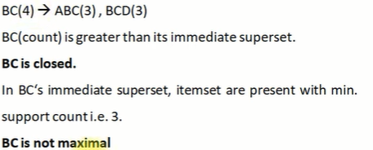
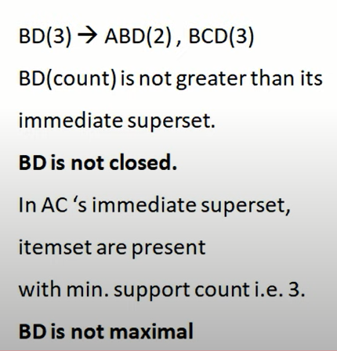
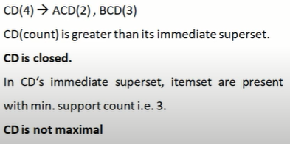
Find Frequent , Closed and Maximal itemset contd..

Slide 11
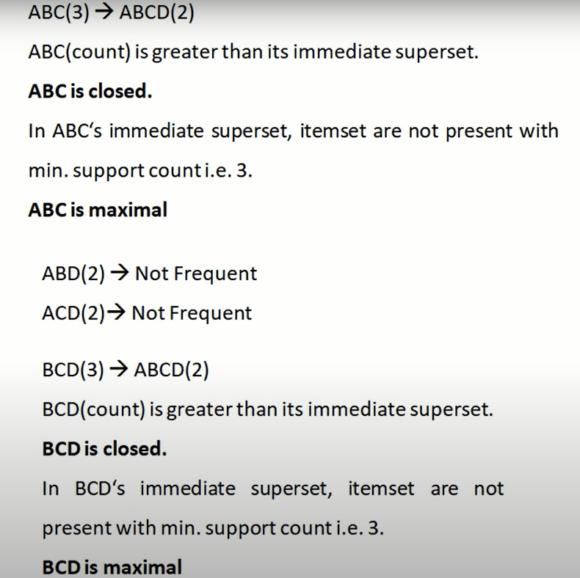
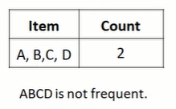
Find Frequent , Closed and Maximal itemset contd..

Slide 12
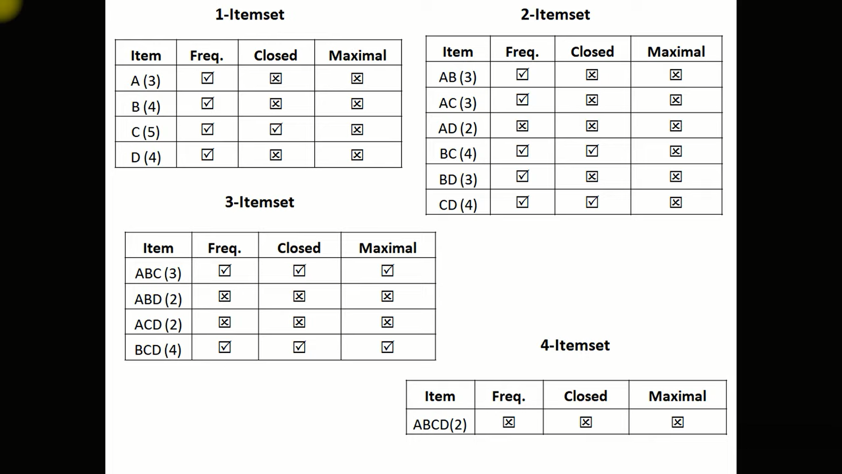
Find Frequent , Closed and Maximal itemset contd..

Slide 13
Mining Multilevel Association rules
Having multiple level of abstraction in concept hierarchy are called multilevel association rule.
Association rules generated from mining data at multiple levels of abstraction are called multiple-level or multi-level association rules.
Items are often from hierarchies
Note: Concept hierarchy is a sequence of mappings from a set of low-level concepts to higher-level, more general concepts.

Slide 14
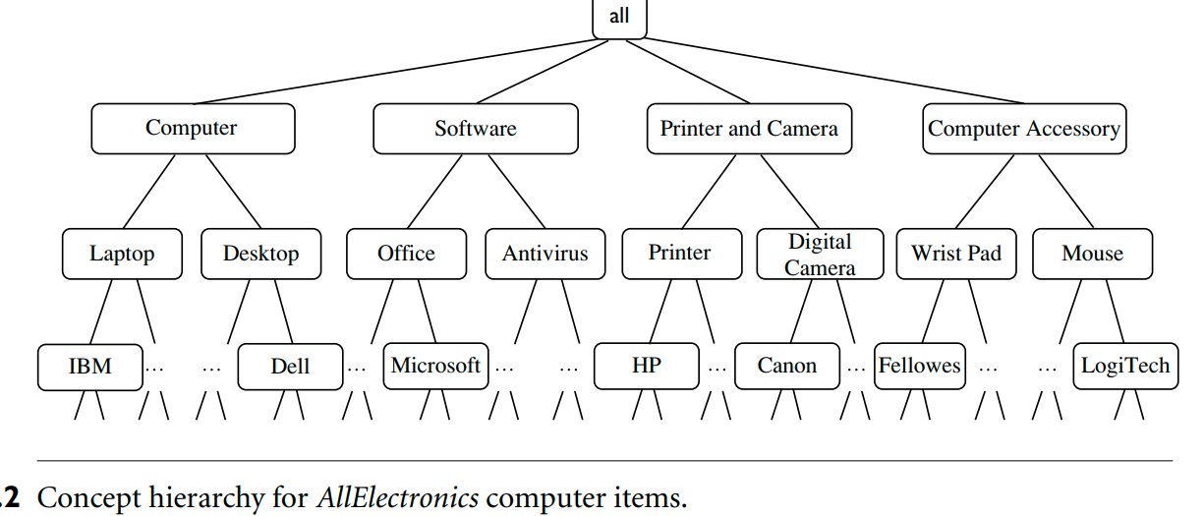
Mining Multilevel Association rules

Slide 15
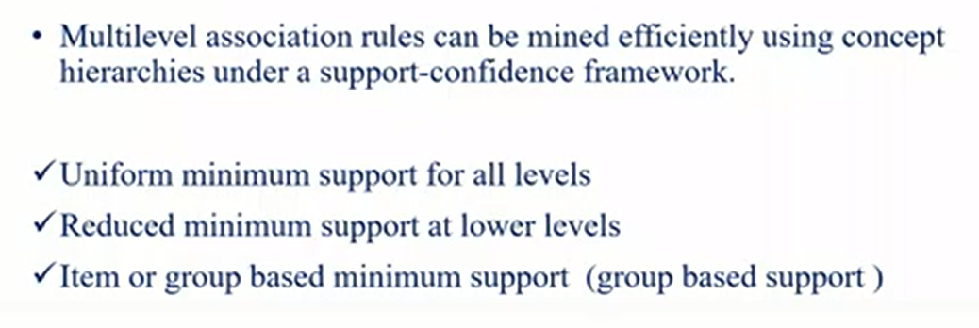
Mining Multilevel association rule

Slide 16
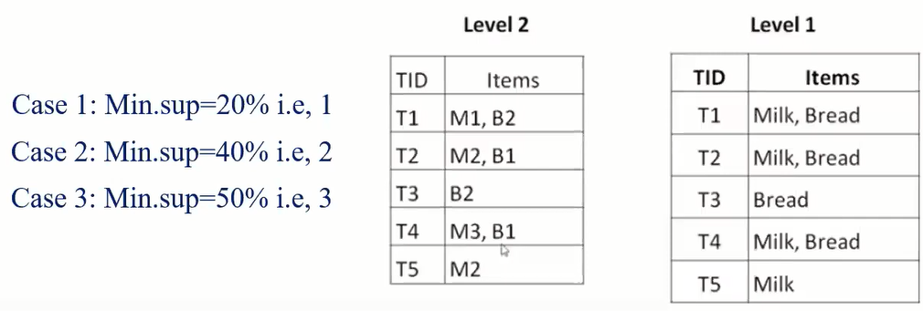
1. Uniform minimum support for all levels

Slide 17
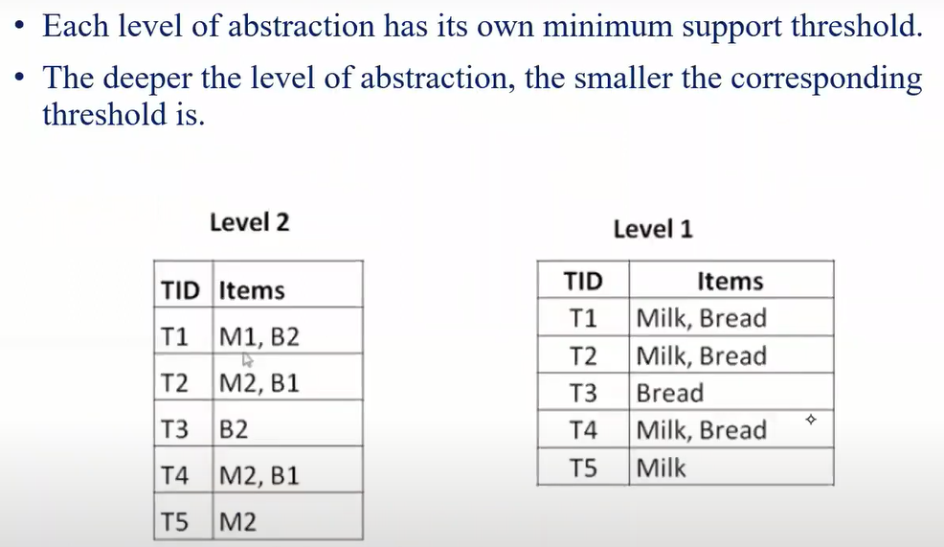
2. Reduced minimum support at lower levels
Level 2 min sup=40%, (2)
Level 1 min sup=50%, (3)

Slide 18
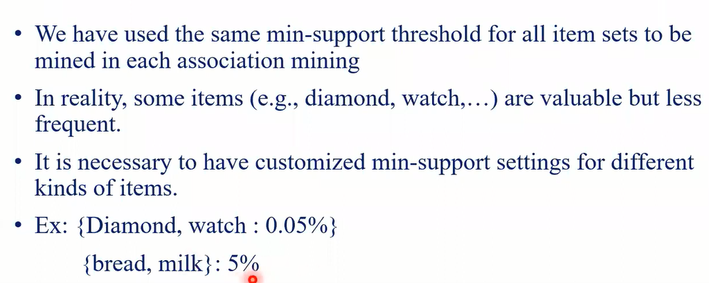
3. Item or group based minimum support (group based support)

Slide 19
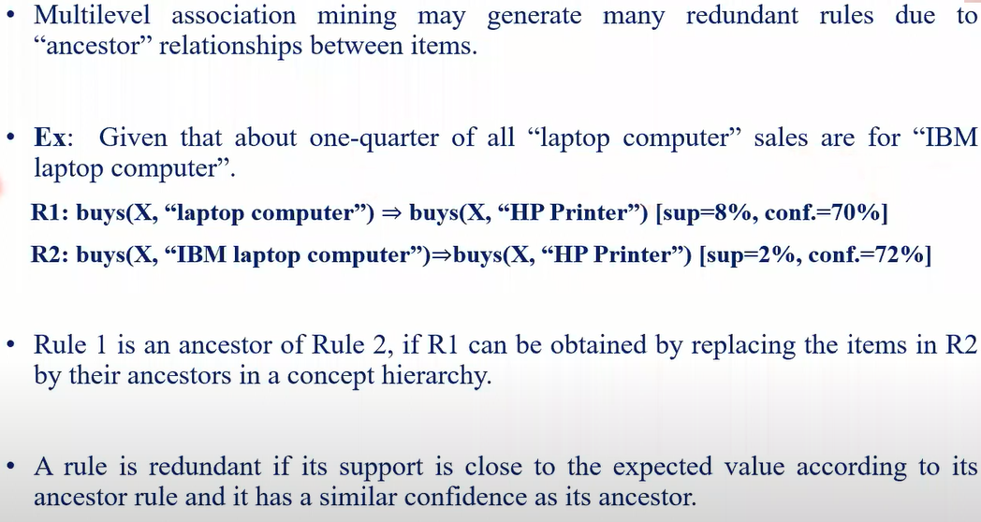
Redundancy filtering at Mining Multilevel Associations

Slide 20
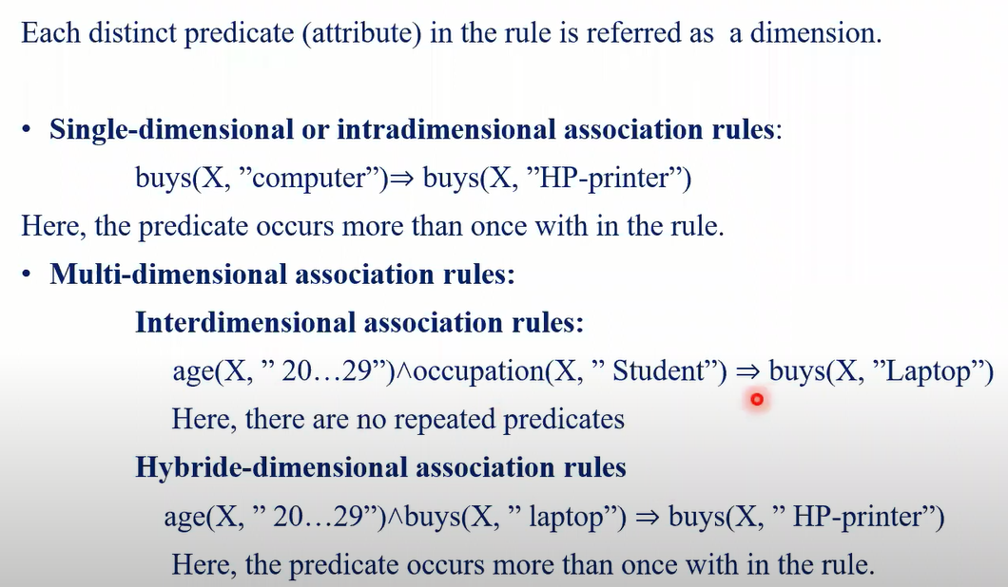
Mining Multi-dimensional Association Rules from relational databases and data warehouses

Slide 21
Thank you

